Slide 1

ARTIFICIAL INTELLIGENCE
&
MACHINE LEARNING
SESSION NO : 27
Support VECTOR MACHINE (SVM) – Part -1

Slide 2
What is a Support Vector Machine (SVM)?
Support Vector Machine, commonly known as SVM, is a popular supervised machine learning algorithm used for solving classification and regression problems.

Slide 3
What is a Support Vector Machine (SVM)?
“Support Vector Machine” (SVM) is a supervised machine learning algorithm which can be used for both classification or regression challenges. However, it is mostly used in classification problems.
In this algorithm, we plot each data item as a point in n-dimensional space (where n is number of features you have) with the value of each feature being the value of a particular coordinate.
Then, we perform classification by finding the hyperplane that differentiate the two classes very well.

Slide 4
What is a Support Vector Machine (SVM)?
Generally, Support Vector Machines is considered to be a classification approach, it but can be employed in both types of classification and regression problems.
It can easily handle multiple continuous and categorical variables.
SVM constructs a hyperplane in multidimensional space to separate different classes. SVM generates optimal hyperplane in an iterative manner, which is used to minimize an error.
The core idea of SVM is to find a maximum marginal hyperplane(MMH) that best divides the dataset into classes.

Slide 5
What is a Support Vector Machine (SVM)?
The goal of SVM is to draw a decision boundary or hyperplane to separate a given dataset into multiple classes.
This decision boundary helps in classifying new examples into the appropriate classes.
The dimension of the hyperplane depends on the features present in the data. If there are only two features (X and Y), a straight line can be drawn as the hyperplane.
Otherwise, when there are more than two features, a plane or higher-dimensional hyperplane is required.

Slide 6
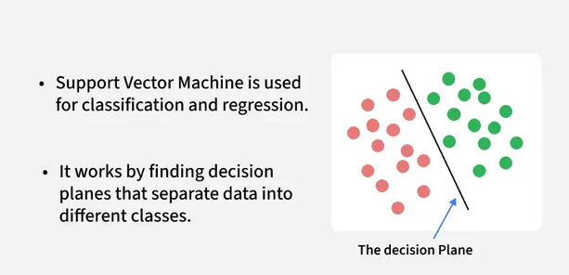
Support Vector Machine

Slide 8
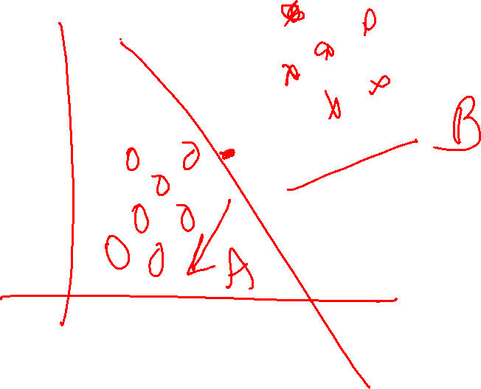

Slide 9
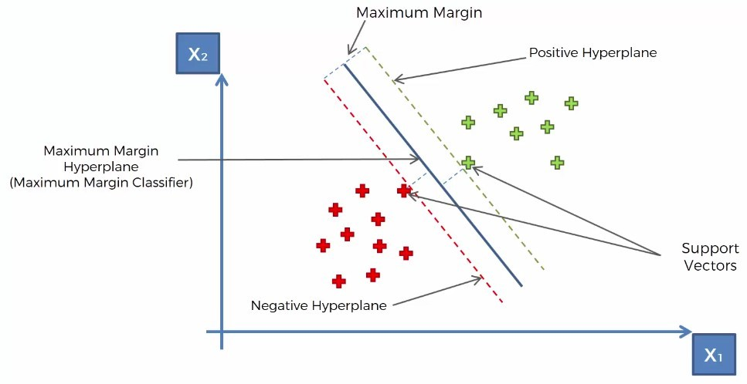
Decision Vectors

Slide 10
What is a Support Vector Machine (SVM)?
Support Vectors
  Support vectors are the data points, which are closest to the hyperplane. These points will define the separating line better by calculating margins.
These points are more relevant to the construction of the classifier.
Hyperplane
  A hyperplane is a decision plane which separates between a set of objects having different class memberships.
Margin
  A margin is a gap between the two lines on the closest class points.
  This is calculated as the perpendicular distance from the line to support vectors or closest points.
  If the margin is larger in between the classes, then it is considered a good margin, a smaller margin is a bad margin.

Slide 11
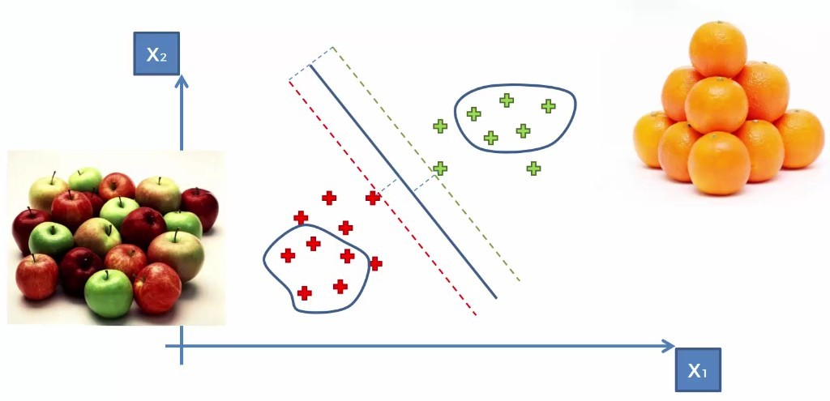
Support Vector Machine

Slide 12
How SVM works ?
The main objective is to segregate the given dataset in the best possible way.
The distance between the either nearest points is known as the margin.
The objective is to select a hyperplane with the maximum possible margin between support vectors in the given dataset. SVM searches for the maximum marginal hyperplane in the following steps:
  Generate hyperplanes which segregates the classes in the best way.
  Select the right hyperplane with the maximum segregation from the either nearest data points.

Slide 13
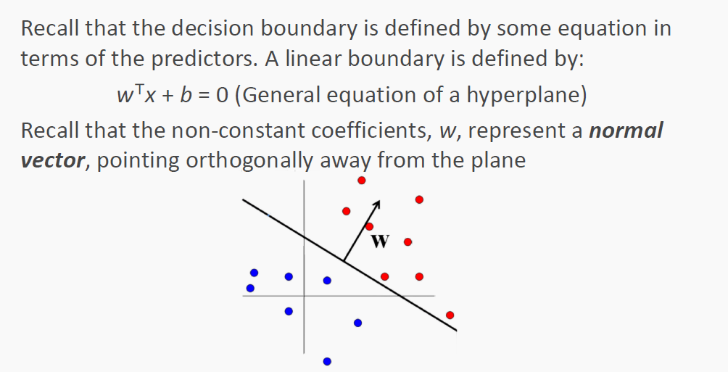
How SVM works ?

Slide 14
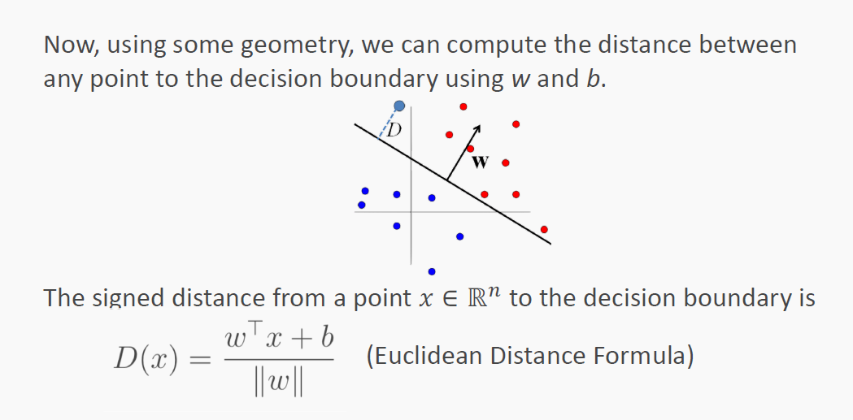
How SVM works ?

Slide 15
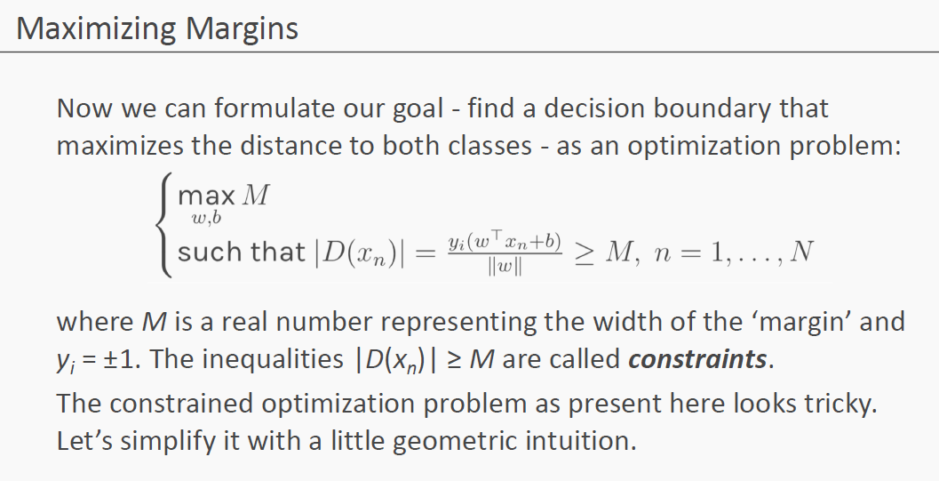
How SVM works ?

Slide 16
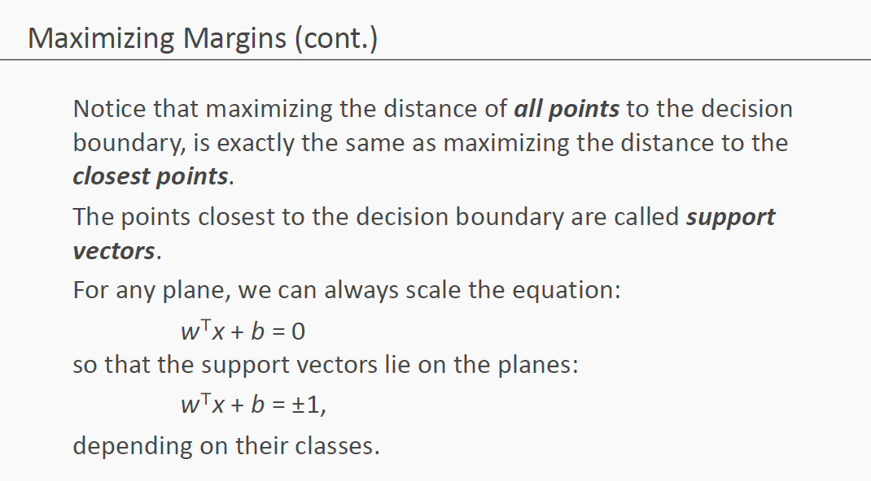
How SVM works ?

Slide 17
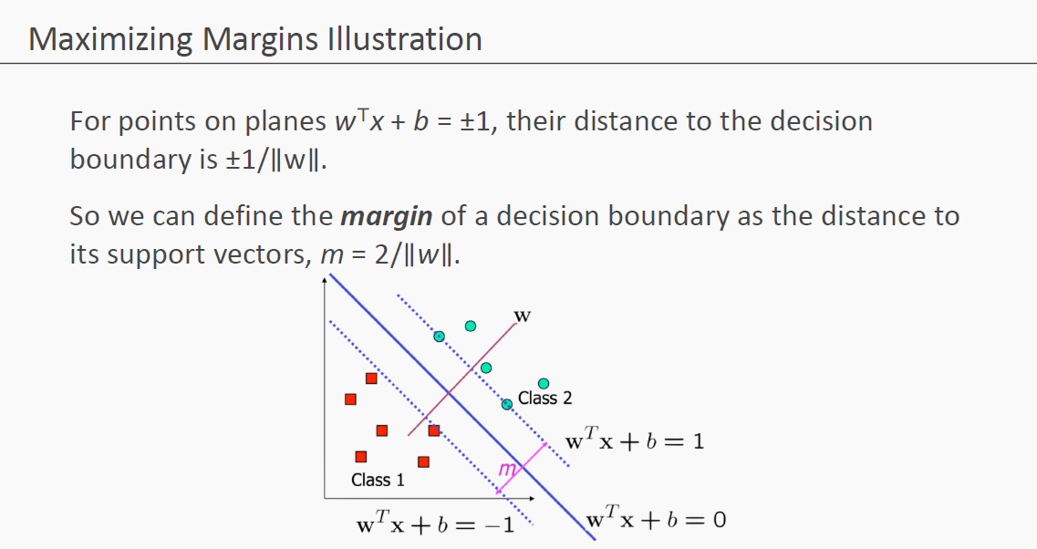

Slide 18
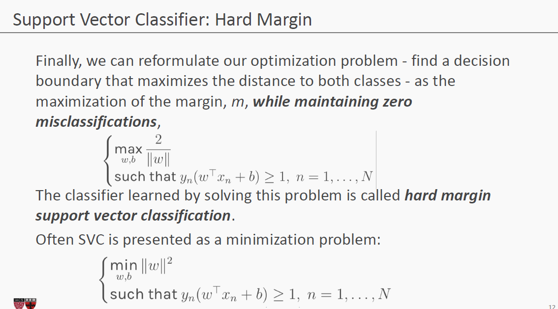

Slide 19
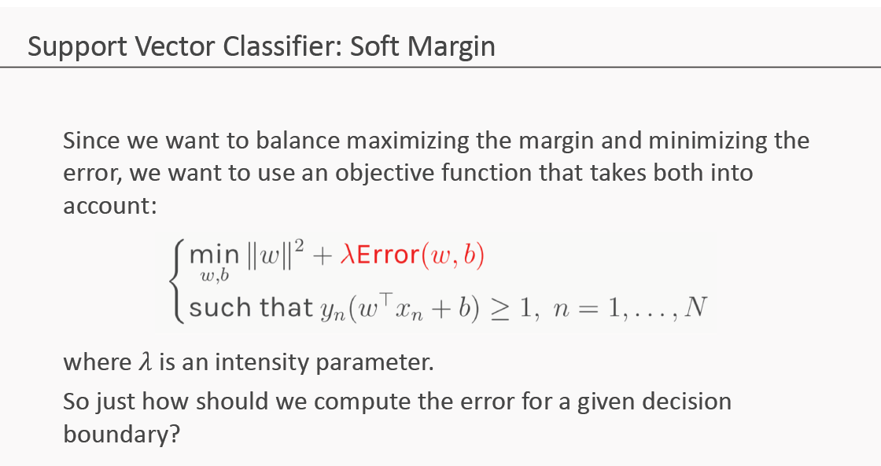
How SVM works ?

Slide 20
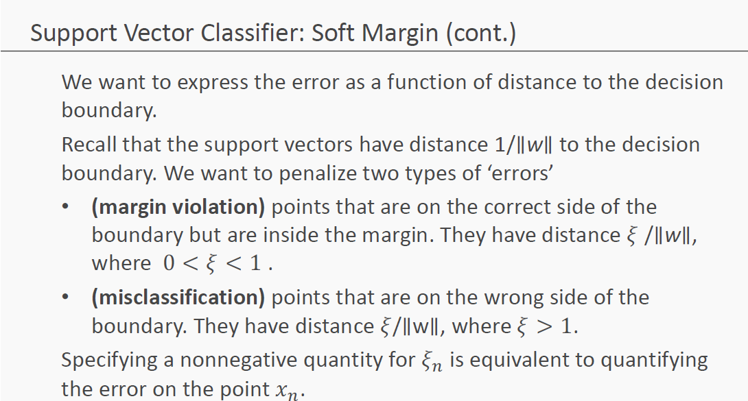
How SVM works ?

Slide 21
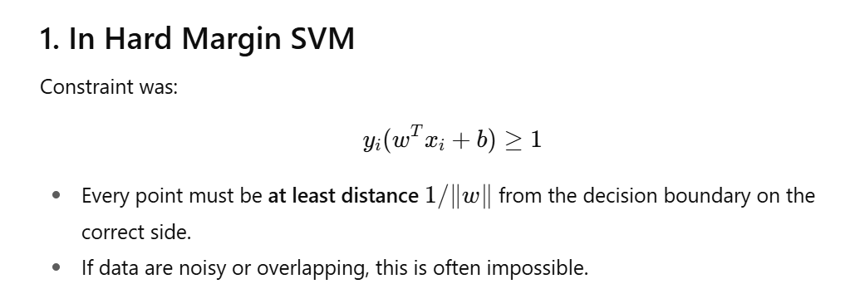
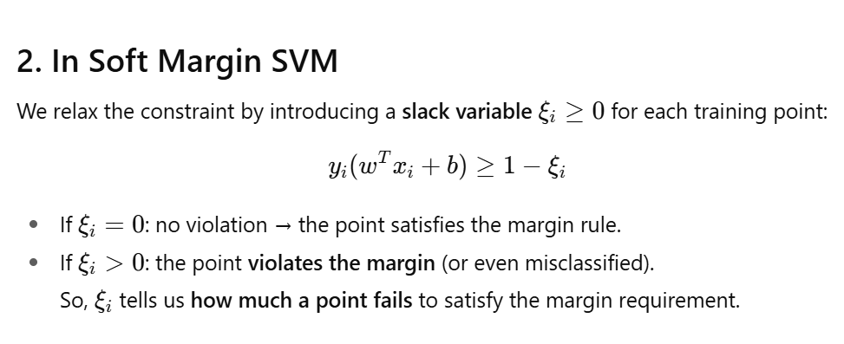

Slide 22
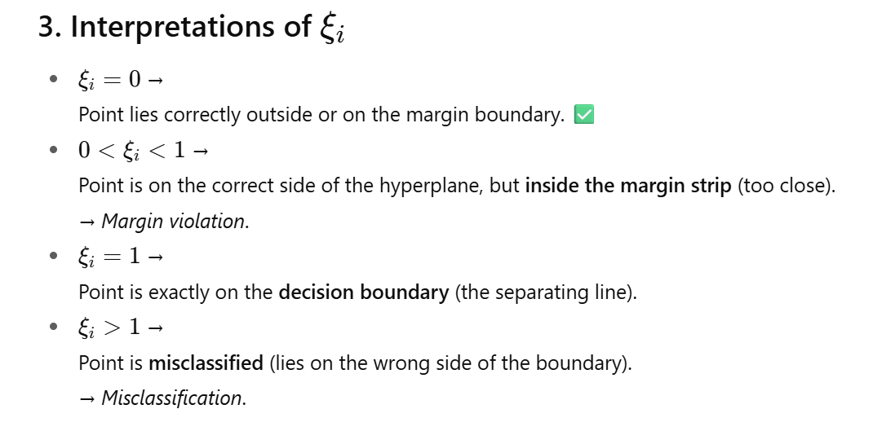

Slide 23
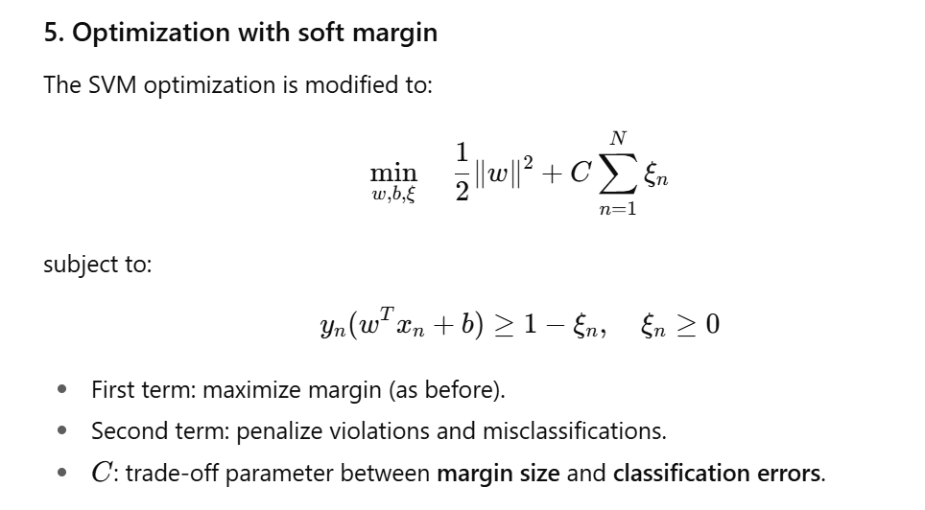

Slide 24
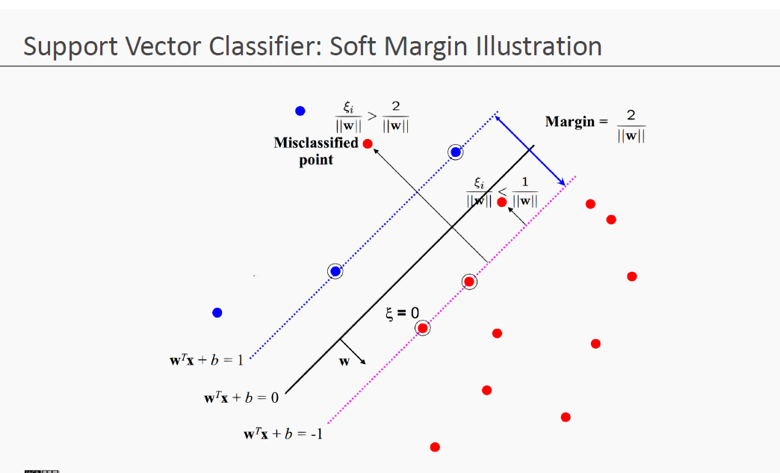
How SVM works ?

Slide 25
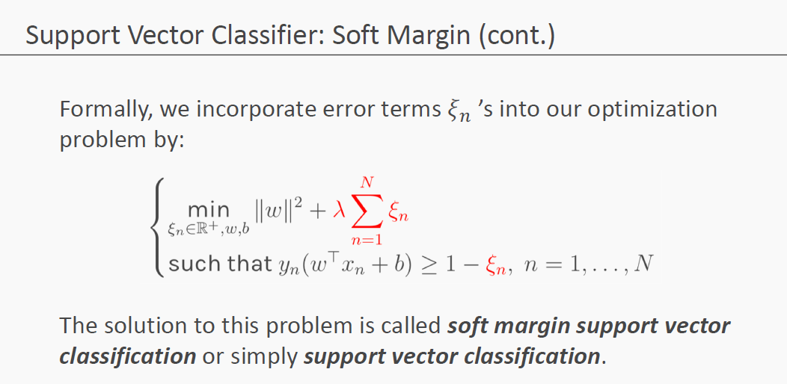
How SVM works ?

Slide 26
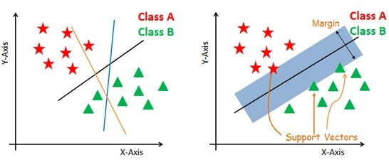
Support Vector Machine

Slide 27
Non-linear and inseparable planes
Some problems can’t be solved using linear hyperplane.
In such situation, SVM uses a kernel trick to transform the input space to a higher dimensional space as shown on the right.
The data points are plotted on the x-axis and z- axis (Z is the squared sum of both x and y: z=x^2=y^2).
Now you can easily segregate these points using linear separation.

Slide 28
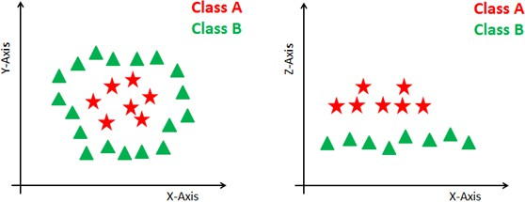
Non-linear and inseparable planes

Slide 29
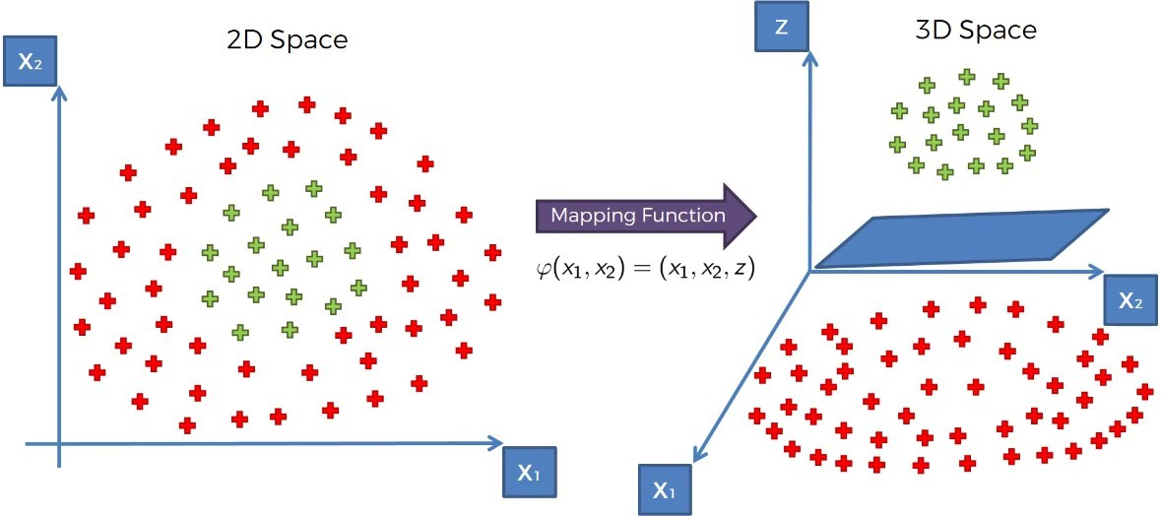
High Dimensional Space Mapping

Slide 30
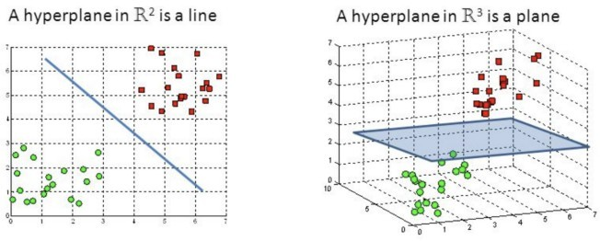
High Dimensional Space Mapping

Slide 31
SVM Kernels
The SVM algorithm is implemented in practice using a kernel. A kernel transforms an input data space into the required form.
SVM uses a technique called the kernel trick. Here, the kernel takes a low-dimensional input space and transforms it into a higher dimensional space.
In other words, you can say that it converts non-separable problem to separable problems by adding more dimension to it.
It is most useful in non-linear separation problem. Kernel trick helps you to build a more accurate classifier.

Slide 32
Types of Kernel
Linear Kernel
Polynomial Kernel
Radial Basis Function Kernel
Sigmoid Kernel

Slide 33

Radial Basis Function Kernel
The Radial basis function kernel is a popular kernel function commonly used in support vector machine classification. RBF can map an input space in infinite dimensional space.
Here gamma is a parameter, which ranges from 0 to 1. A higher value of gamma will perfectly fit the training dataset, which causes over-fitting. Gamma=0.1 is considered to be a good default value.
The value of gamma needs to be manually specified in the learning algorithm.

Slide 34
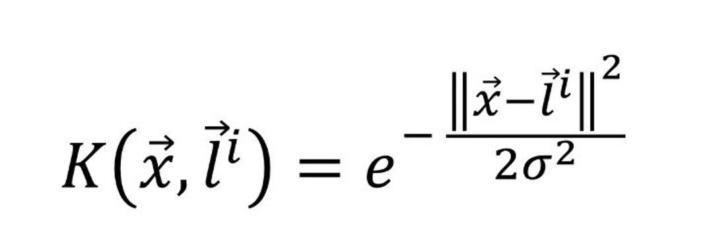
Radial Basis Function Kernel

Slide 35
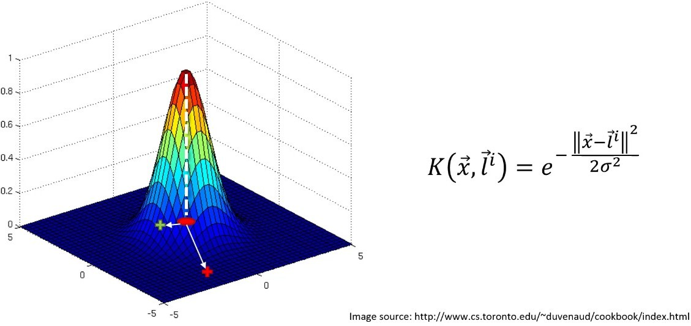
Radial Basis Function Kernel

Slide 36
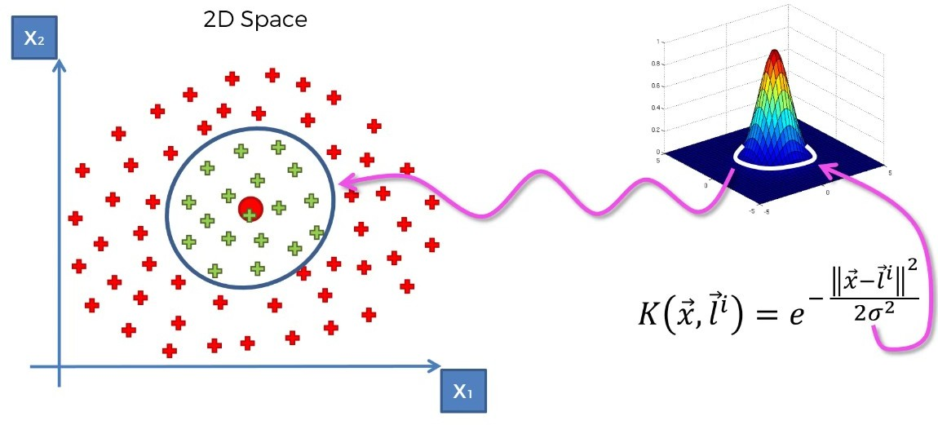
Radial Basis Function Kernel

Slide 37
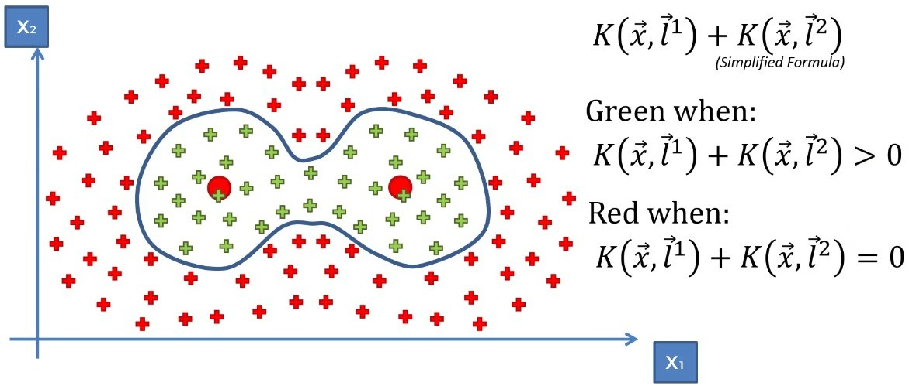
Radial Basis Function Kernel

Slide 38
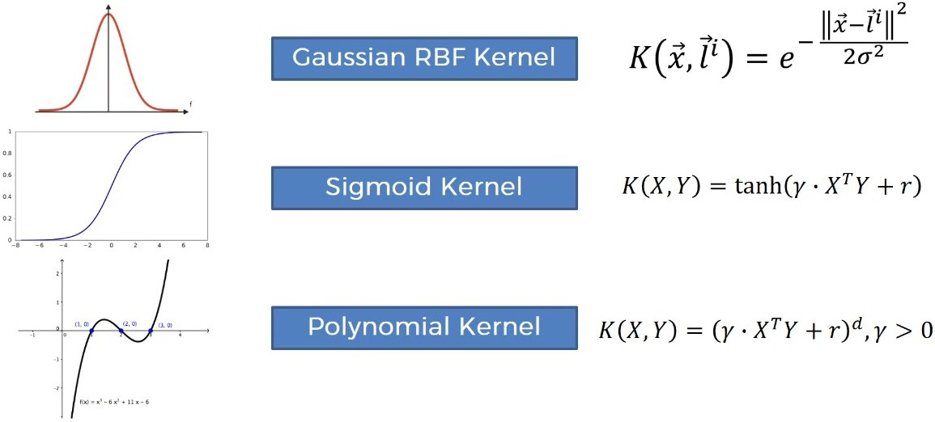
Types of kernel

Slide 39
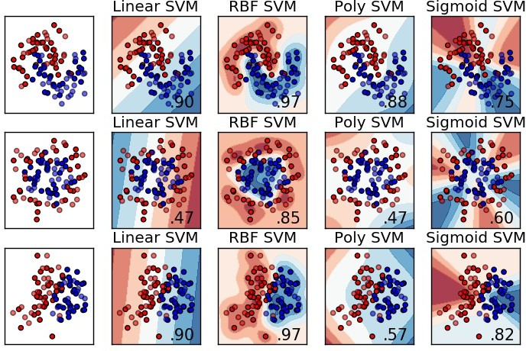
Types of kernel

